Slide 1
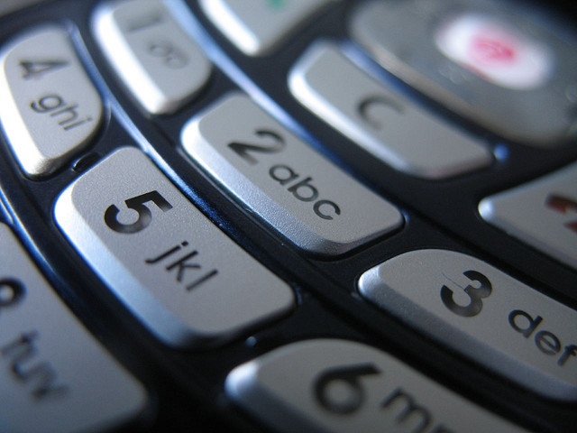
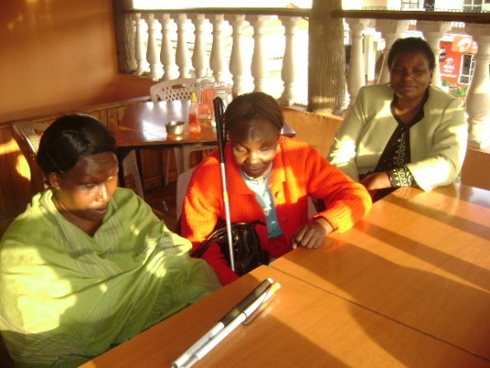
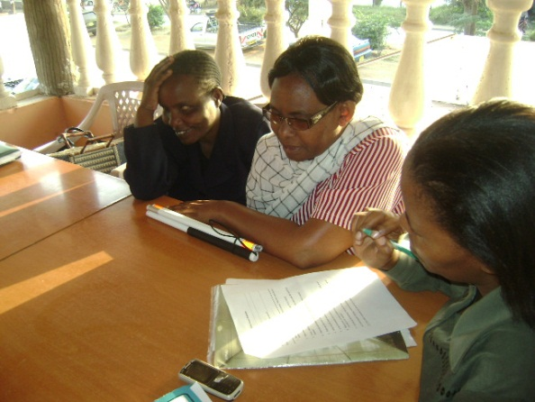
The Use of Mobile Money Services and Platforms among the Visually Impaired in Kenya: Preliminary Themes
Researchers: Dr. Ndunge Kiiti (Houghton College, NY) and Dr. Jane Mutinda (Kenyatta University, Kenya)
IMTFI Conference 2012

Slide 2
The Challenge
“On the negative side…because of this challenge of being visually impaired, the phones available nowadays are not audible…they don’t talk. You can’t operate it…to tell you everything, so it’s easy that a person can sometimes read for you the wrong money figure that is in the phone account or any other message….and if they distort it, they can take a share of what is there” (Interviewee, personal communication, 2010)
VIs Technology Dependency Loss

Slide 3
Research Process
Context
Understanding Context
Literature Review
Knowledge Building
Field Work
Impact
Documentation/Dissemination
Policy and Program Implications
Workshop
Design (Methodology)
Conceptualization

Slide 4
Visual Impairment in Kenya
1/4 of Kenya’s population impacted by disabilities—518,000 are visually impaired (Kenya Union of the Blind, 2009)
Only 21% of children with visual impairment attending school (Ministry of Education, 2009)
Gender Dynamics of VIs—55% females; 45% males (Kenya Union of the Blind, 2009)
Study confirms M-PESA services tend to benefit individuals of higher, socio-economic status (Mbiti & Weil, 2010)

Slide 5
Definitions
Disability: “A physical, sensory, mental, or other impairment including any visual, hearing, learning or physical incapacity which impacts adversely on social, economic or environmental participation” (Persons with Disabilities Act, 2003)
Visual Impairment: The loss of vision which, even after correction, adversely affects a person’s performance or execution of typical everyday tasks (Murugami, 2010)
Includes blindness

Slide 6
The Poverty-Visual Impairment Link
Poverty-Health Link
Poverty as a cause or consequence of poor health (Kuper, Polack, et al, 2008)
Childhood blindness correlated with socio-economic development (Njuguna, Msukwa, et al, 2009)
Poverty-Visual Impairment Link
Study in 3 countries highlights relationship (Kuper, Polack, et al, 2008)

Slide 7
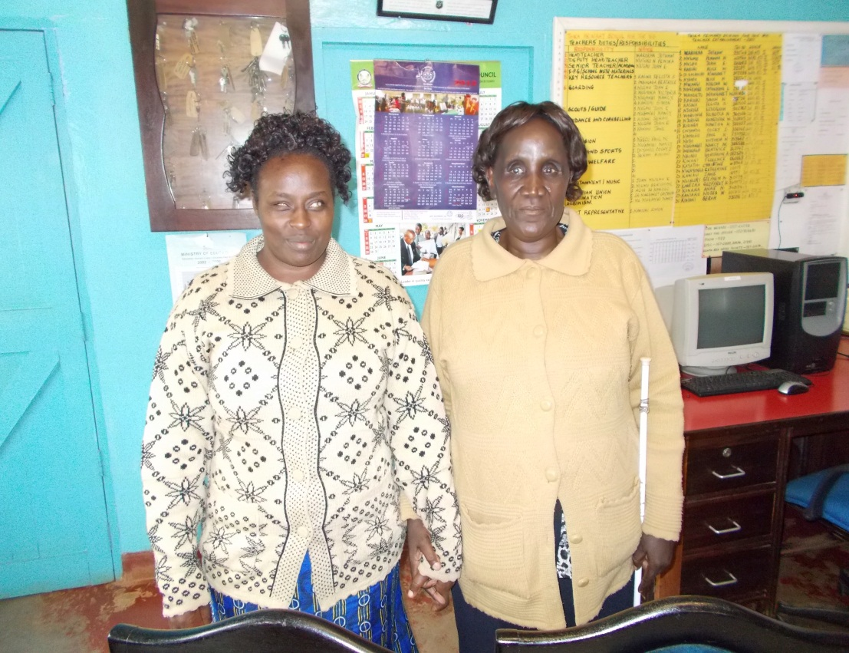
Words of Reflection
“Poverty and Visual Impairment are brothers” (Interviewee, personal communication, 2012)

Slide 8
The Poverty-Visual Impairment-Technology Link
Technology as Interdisciplinary Approach
“products, resources, methodologies, strategies, practices and services…to promote functionality for visually impaired people with regard to autonomy, independence, quality of life, and social inclusion” (Alves, Monteiro, Rabello, et al, 2009, p. 148)
Technology must be undergirded by training and support services (Resnikoff, Pascolinini, et al, 2004)

Slide 9
VI’s and Mobile Technology
Experience: Socio-cultural & economics
Use/Access: Products & Services
Policy, Practice & Lessons
IMPACT

Slide 10
Preliminary Themes
Opportunities
Obstacles
Quality of Life or Livelihood
Integration/Inclusion
Ability/Diversity
Education/Training
Resources
Relevant Initiatives
Poverty or Lack of Resources
Isolation/Stigma
Burden/Inability
Illiteracy
Commitment/Allocation
Lack of Data/Evidence

Slide 11
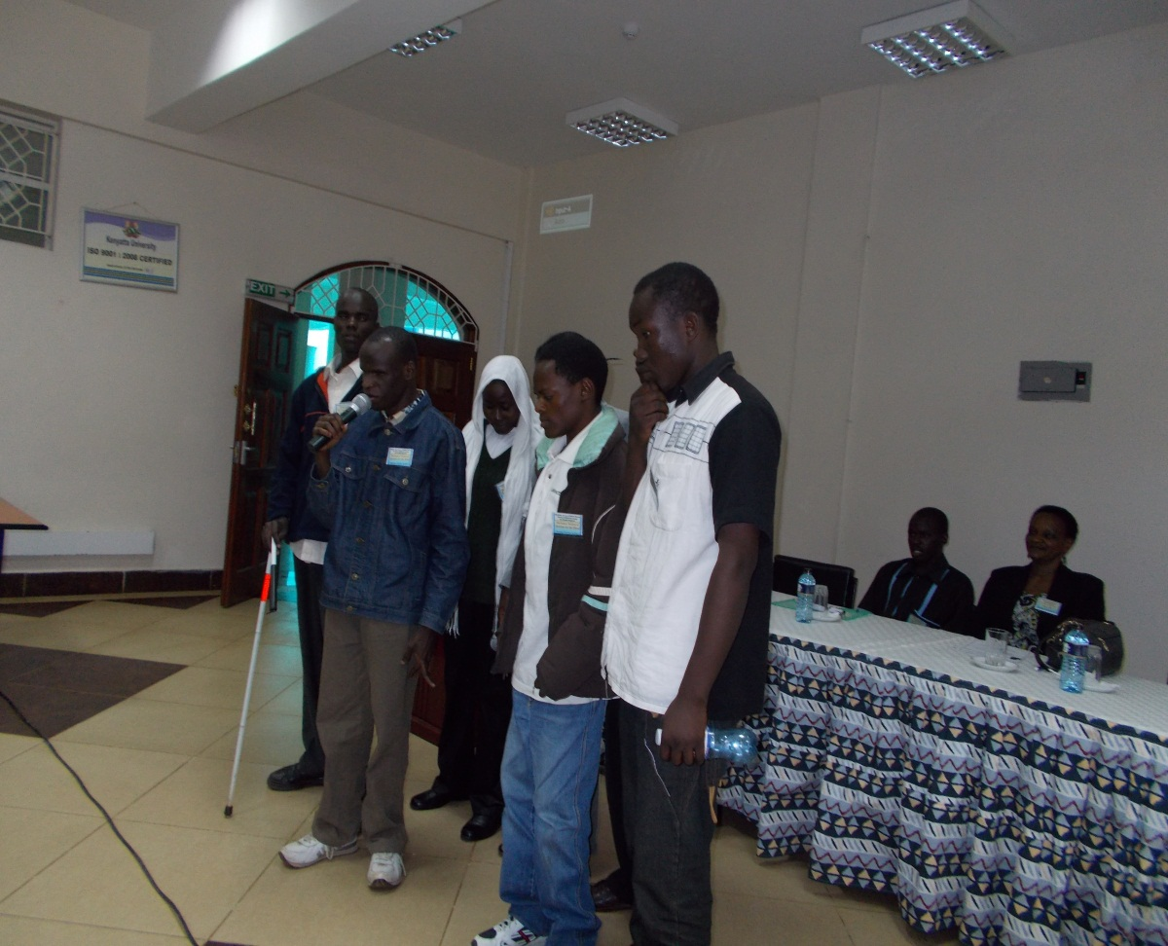
Words of Reflection
“
“We are only impaired, not disabled” (Interviewee, personal communication, 2012)
“We are people with special abilities” (Interviewee, personal communication, 2012)

Slide 12
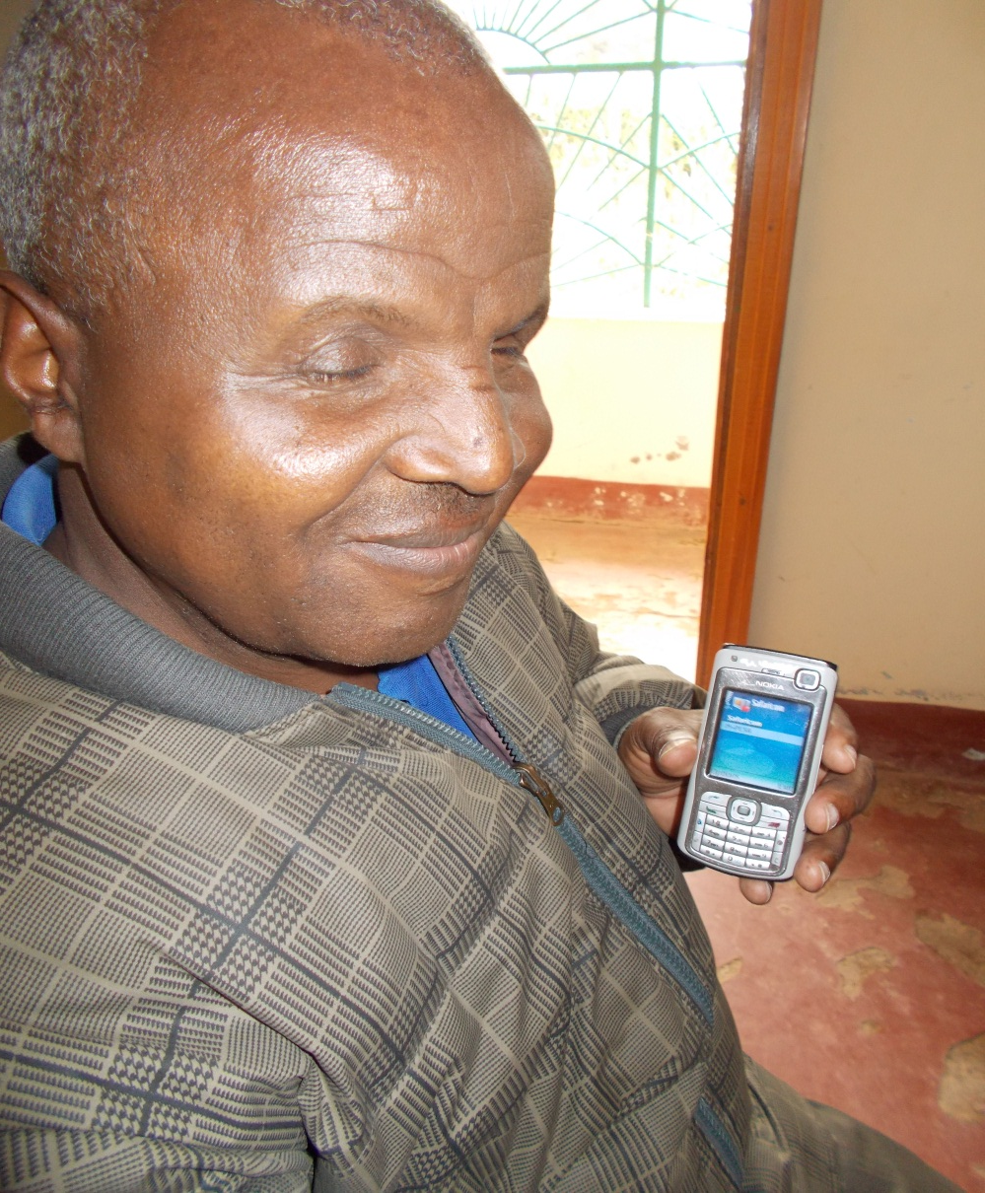
Words of Reflection
“A person with any disability is entitled to access….appropriate means of communication…. materials and devices to overcome constraints arising from the person’s disability” (Constitution of Kenya, 2010, p. 63)

Slide 13
Use of Technology
Opportunities
Obstacles
Affordability
Independence/Privacy
Security
Improve Livelihoods
Diversification
Policy
Cost/Expensive
Lack of Autonomy
Distrust/Fraud
Poverty Cycle
Network Power
Reality/Practice

Slide 14
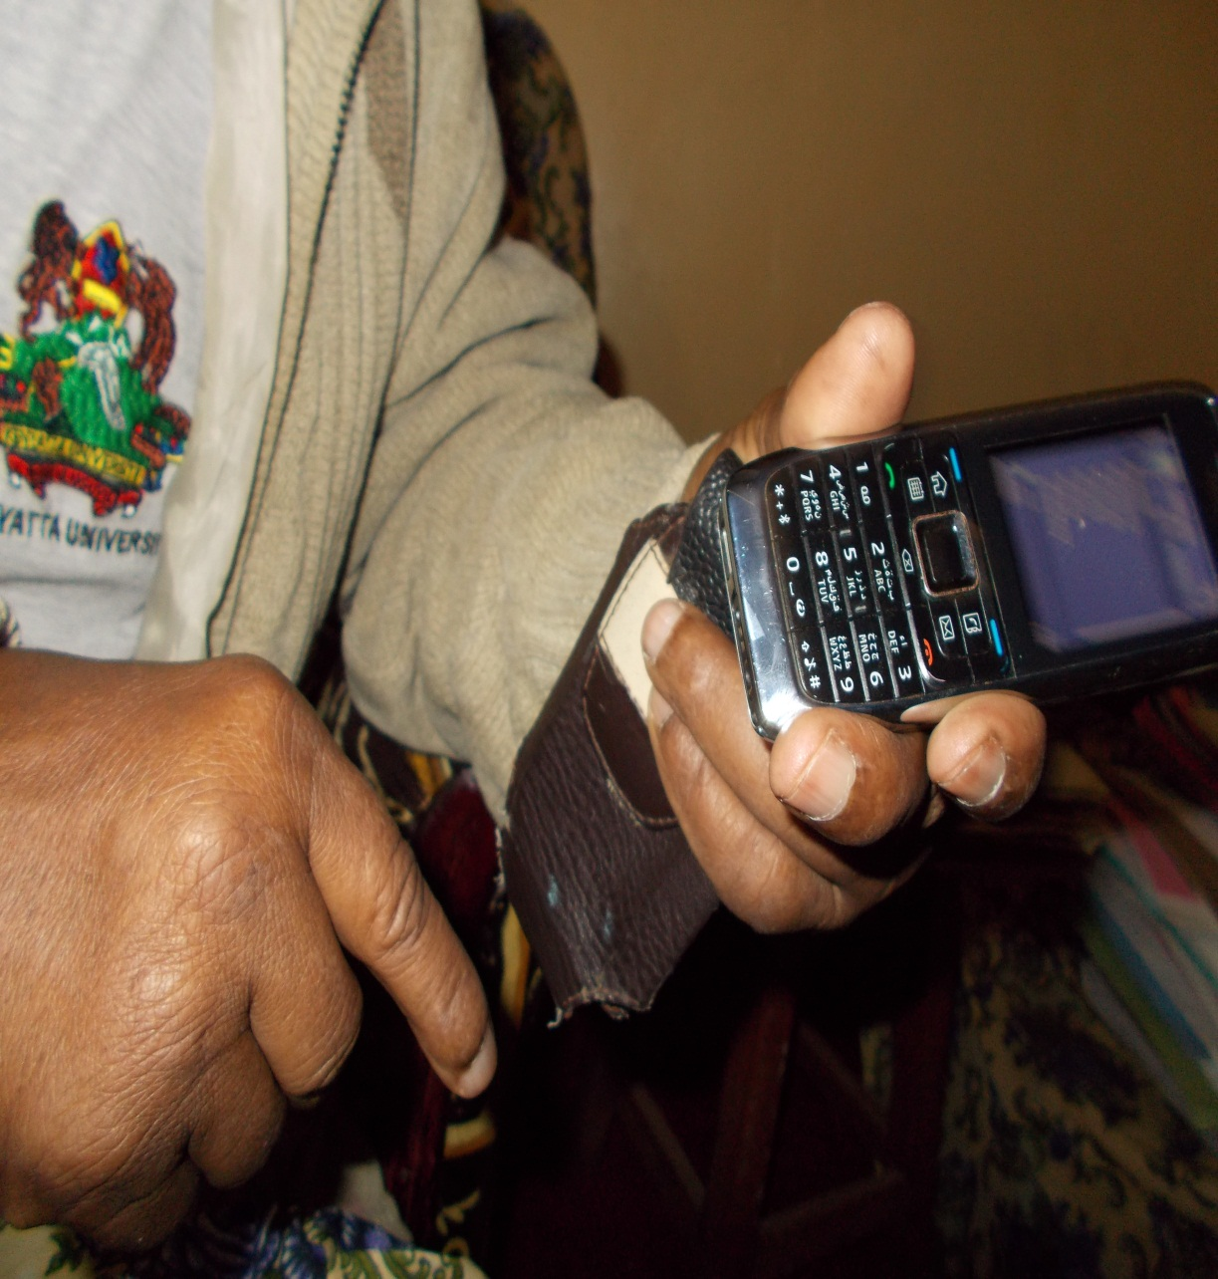
Words of Reflection
“Mobile Banking is supposed to work for everyone, so it is paramount to provide access of these resources”
(Member Organization working with VIs, 2012)

Slide 15
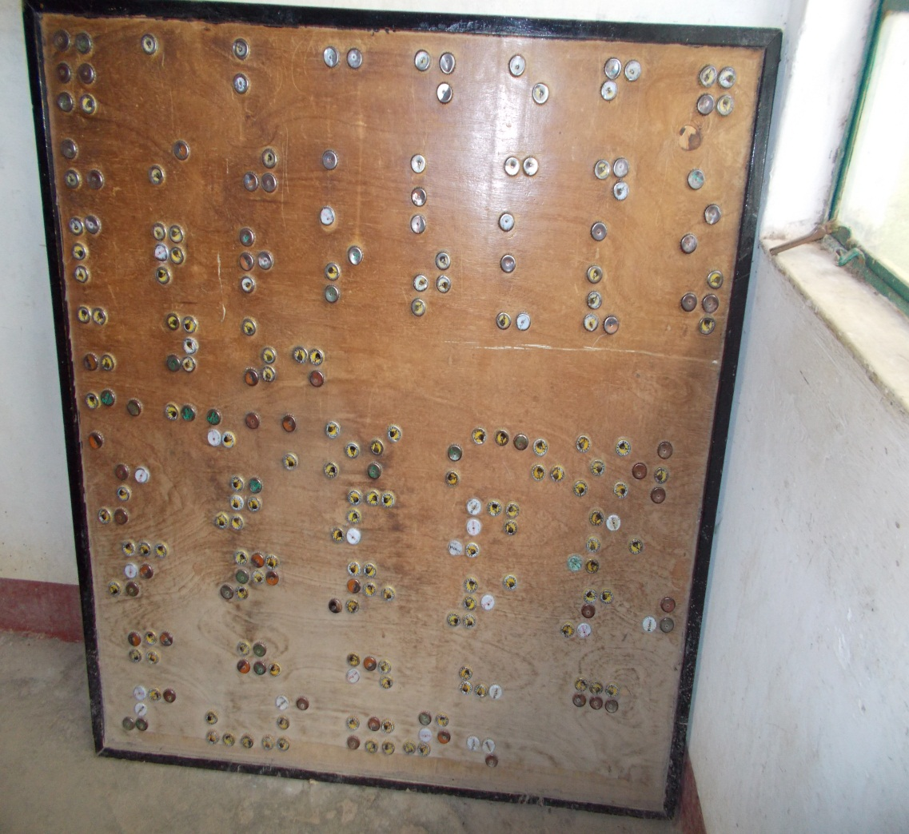
Words of Reflection
“Access to Information is a Human Right—but VIs aren’t able to access” (Interviewee, personal communication, 2012)

Slide 16
Policy Implications
Selected International Frameworks
Selected National Frameworks
UN Convention on the Rights of Persons with Disabilities—2006 (Autonomy, Dignity, Equality, Inclusion, Respect of Difference)
Africa Decade of Persons with Disabilities
International Labour Organization (ILO) Convention
The Constitution of Kenya
State of Disabled People’s Rights in Kenya--2007
The Persons with Disabilities Act—2003
Vision 2030
National Development Plan

Slide 17
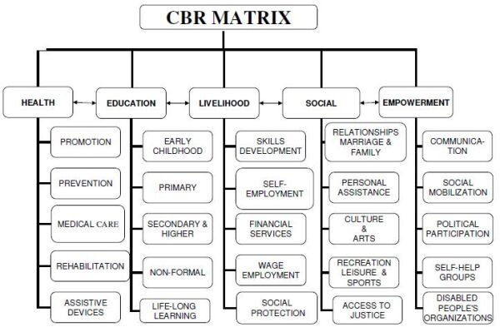
Framework: WHO CBR Matrix

Slide 18
Policy Implications: Selected Themes
Education
Sensitization of Society
Formal (Curriculum, Assessment, etc)
Improve Data/Information System of VIs
Appropriate Products and Services
“The needs of people with impairments are not addressed by the market; a phenomenon that tends to be repeated with each new product and technology (Vanderheiden as cited in Pedlow, et al, 2010, p. 133)
Accessibility (Cost, Training, Gender, Security, etc)

Slide 19
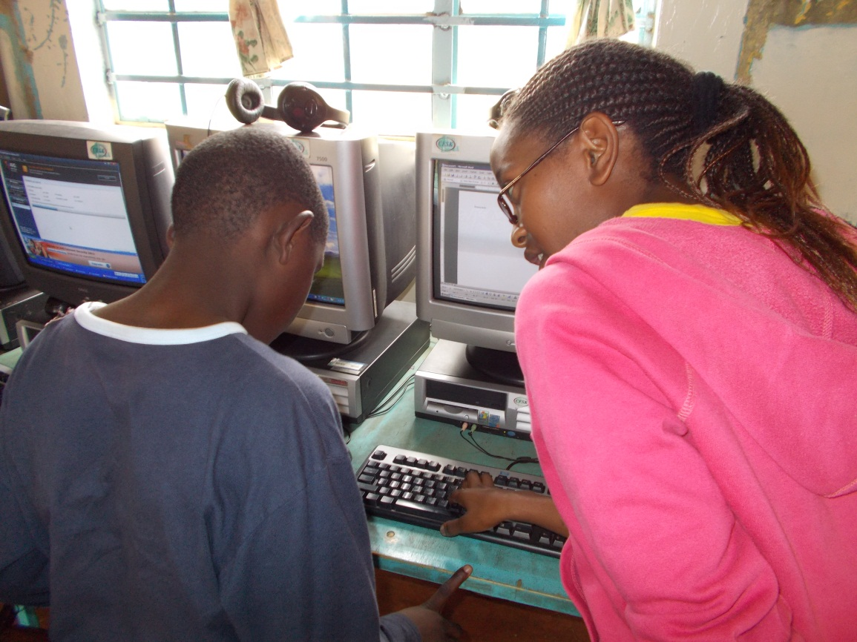
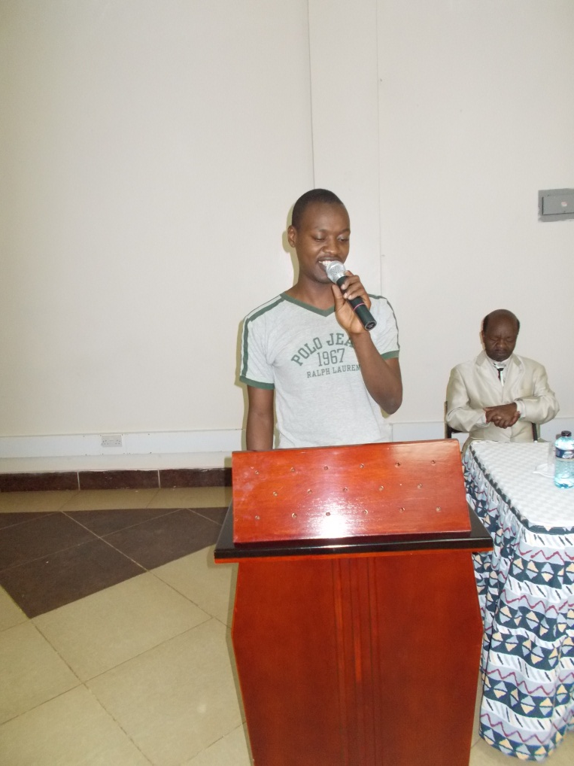
Policy Implications: Selected Themes
Create Employment Opportunities for VIs

Slide 20
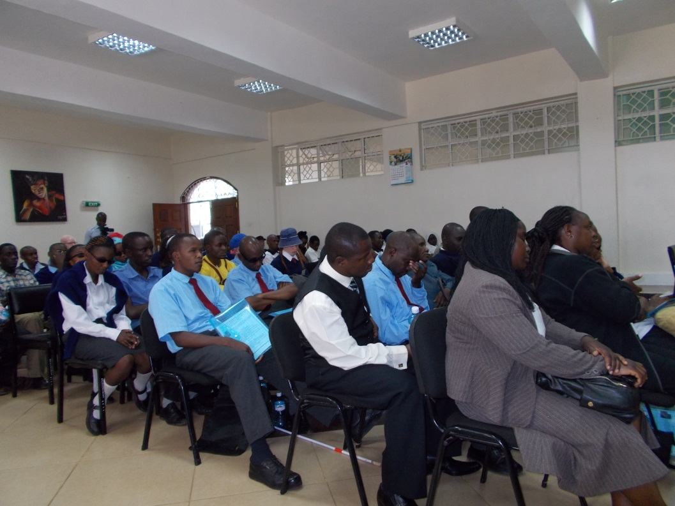
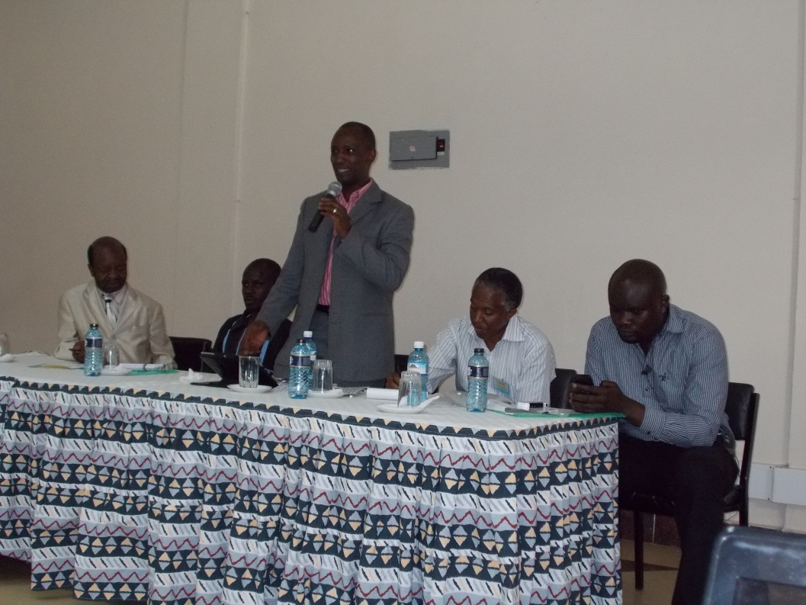
Policy Implications: Selected Themes
Effective Partnerships for Multi-Sectoral Approach

Slide 21
The Urgency
“Every day, millions of people around the world who have a disability, are faced with frustrating—even impossible-situations…..these people should enjoy the same services and opportunities in life as everyone else” (ITU as cited in Pedlow, Kasnitz & Shuttleworth, 2010, p. 147)

